Slide 1
C Constructs
Introduction to C

Slide 2
Features of C
C is Simple in a sense that it provides structured approach.
C Programs can be executed in different machines (machine independent)
C has right library with built in functions and data types.
Programs written in C are fast in execution.
C Program offers modularity in the form of libraries.
C offers efficient memory management through pointers.
C programs are extensible.
C is a general purpose programming language and has wide range of application area.

Slide 3
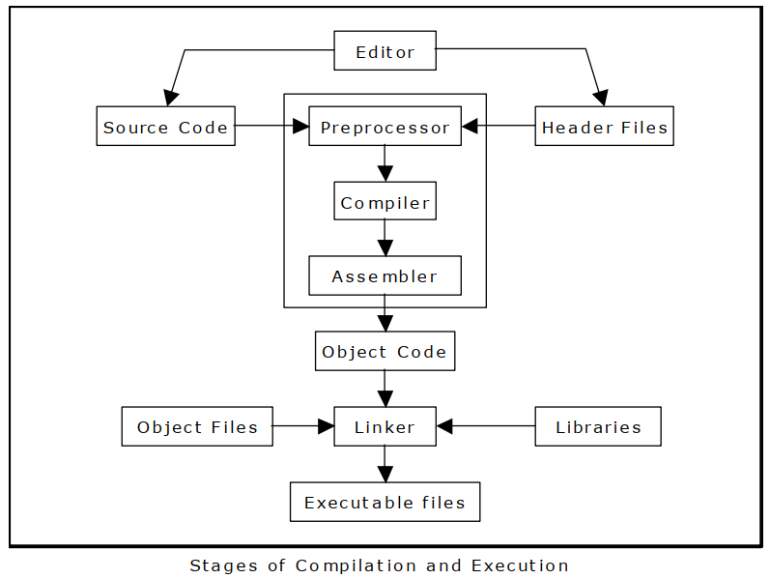

Slide 4
C Program Compilation
C Preprocessor accepts C Source program and converts it into a file acceptable by the compiler. C Preprocessor are generally of three types: #include, #define and #ifdef. #ifdef is also known as conditional compilation that creates adaptability to different operating environment.
C compiler translates C language code into machine assembly language.
C assembler accepts C compiler output and creates object code. If the program does not contain any external function calls, he code is directly executable.
Linker combines reference libraries with the main source code to create executable program.

Slide 5
C Keywords:
Keywords are reserved words whose meaning has already been defined to the compiler and these words cannot be used any other ways except how it as been pre-defined.
C has 32 keywords: Flow Control: if, else, return, switch, case, default Loops: for, do, while, break, continue Common types: int, float, double, char, void Structures: struct, typedef, union Counting: sizeof, enum Others: extern, signed, unsigned, long, short, static, const, auto, volatile, register The ONE THAT WE NEVER USE: goto

Slide 6
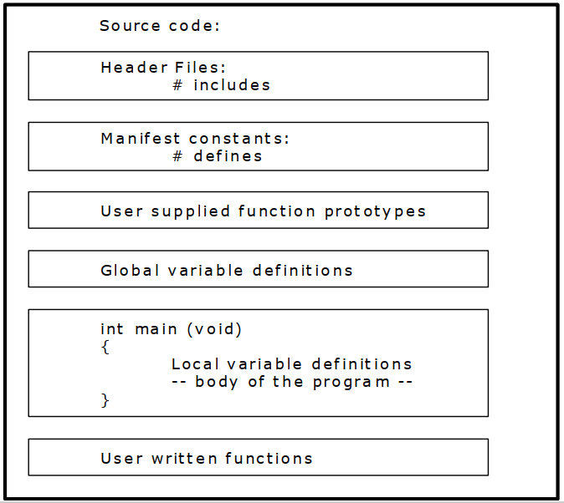

Slide 7
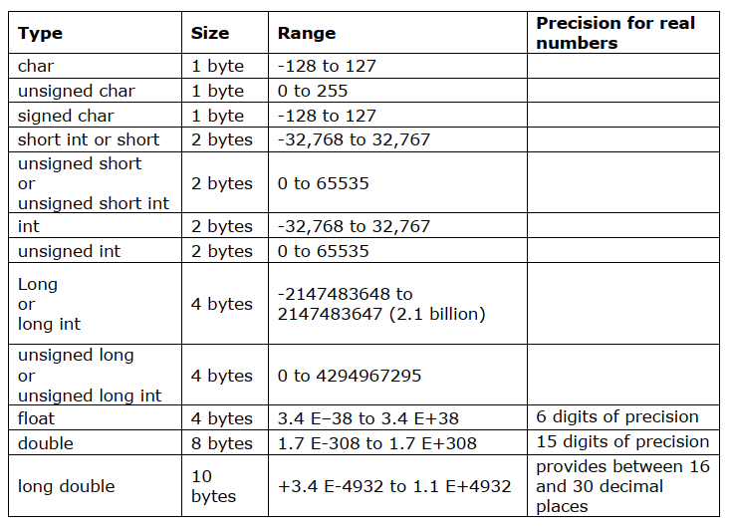

Slide 8
Identifiers
Identifier are the names given to variables, functions, labels or any other user created entities.
First letter of the identifier should be a letter or an underscore ( _ )
Everything in C is case sensitive, i.e count, Count and COUNT are three different entities in C.
Identifier in C can be of maximum 32 characters in length.
To declare a variable in C: var_type list_of_variables;
Variable are declared in three basic places: inside functions (local variables), in function definition (formal parameters) and outside function (global variables)

Slide 9
Variables and Constants
Variables are the identifiers whose value keeps on changing throughout the program. Constants are the identifiers whose values cannot change throughout the program.
Variables: int a; char b; float c,d; double e
Constants: const int a=4; char const b=‘a’; const float c=3.14; double const e=5.55;
The difference between a cosnt identifier and a manifest constant is that the #define causes the preprocessor to do a search-and-replace operation throughout the code. On the other had, const allows the compiler to optimize its use.

Slide 10
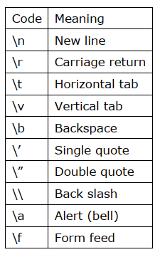
Escape Sequence
An escape sequence is a sequence of characters that does not represent itself when used inside a character or string literal, but is translated into another character or a sequence of characters that may be difficult or impossible to represent directly.

Slide 11
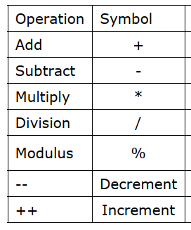
Operators: Arithmetic Operators

Slide 12
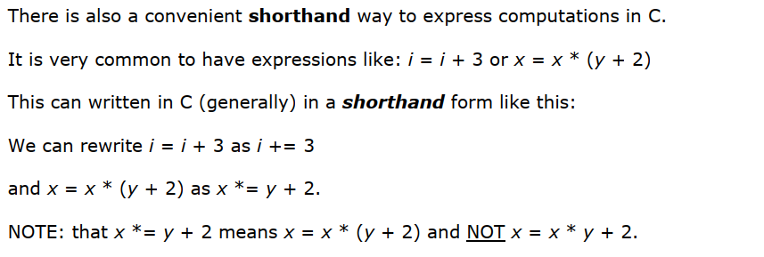
Operators: Arithmetic Operators

Slide 13
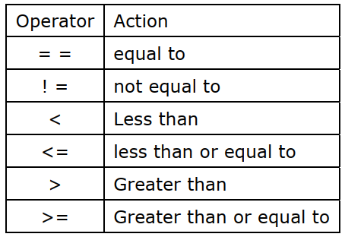
Relational Operators

Slide 14
Logical Operators:
Logical operators are usually used with conditional statements. There are three basic logical operators: && for logical AND, || for logical OR and ! for logical not.
Eg: if (a>b && a>c) printf(“%d is largest”,a) elseif (b>a && b>c) printf(“%d is largest”,a) else printf(“%d is largest”,a)

Slide 15
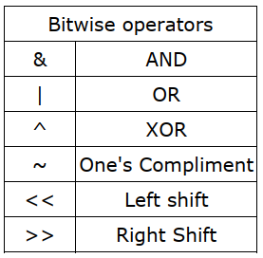
Bitwise operators

Slide 16
Ternary Operators
Makes use of ? and : symbols
Normal form: a ? b : c Evaluation of this expression begins with the evaluation of the sub-expression ‘a’. If the value of ‘a’ is true then the while condition expression evaluates to the value of the sub expression ‘b’. If the value of ‘a’ is FALSE then the conditional expression returns the value of the sub-expression ‘C’.
Example: int largest= ( a > b ) ? a : b

Slide 17
sizeof operator
In situation where you need to incorporate the size of some object into an expression and also for the code to be portable across different machines the size of unary operator will be useful. The size of operator computes the size of any object at compile time. This can be used for dynamic memory allocation.
Example: sizeof (char) = 1 sizeof (int) = 2 sizeof (float) = 4 sizeof (double) = 8

Slide 18
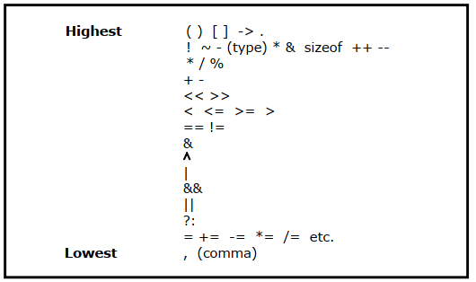
Order of Precedence

Slide 19
Type Casting
int a=5; int b=2; int c=a/b; printf(“Integer Division”); printf(“%d”,c); float d=(float) (a/b); printf(“Type Casted Output”); printf(%f”,d)

Slide 20
Type Casting
int a = 3; int b = 2; float c; c = b * (a / b); printf ("2 * (3 / 2) = %f\n", c);

Slide 21
Reading and Writing Character Input
char c=getchar(); char c=getch(); char c=getche(); putchar ( c );

Slide 22
Simple Demo of Character Input/Output | Class Discussion | Idea Cracking

Slide 23
String Input-Output
char name[25]; gets(name); puts(name);
puts() recognizes escape sequences just as well as prinft() does but it cannot format numbers or do format conversions (typecasting). Hence, puts() takes up less space and runs faster than printf();

Slide 24
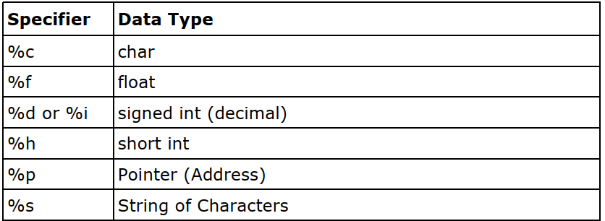
Formatted Input Output : scanf()
printf(“How are you today?”); printf(“Here I am \n This is Me!”); printf(“%d”,12);

Slide 25
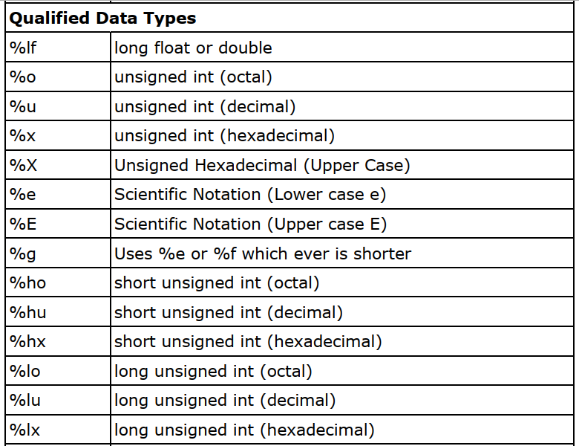

Slide 26
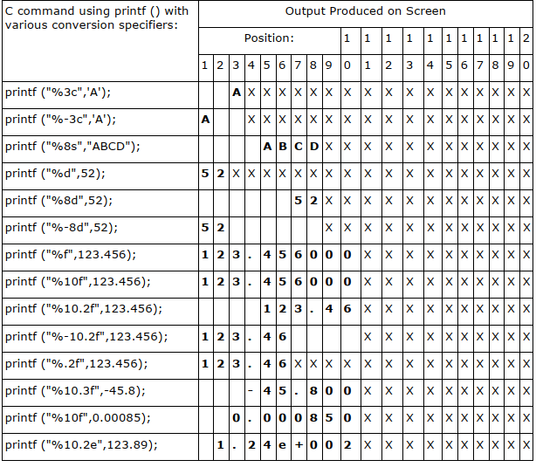

Slide 27
Formatted Input Output : scanf()
int num; printf (“Enter a number: “); scanf(“%d”, &num); printf(“The number you have entered was %d\n”, num);

Slide 28
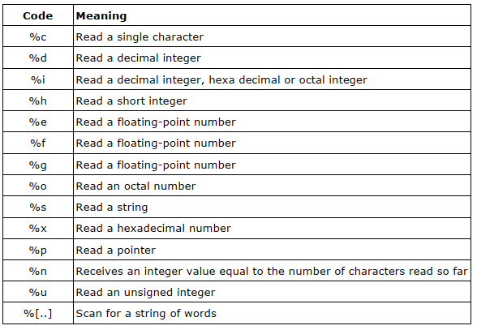

Slide 29
Programming Exercise
Write a program to read two numbers from the user and display the sum. (Subtraction, multiplication and division too)

Slide 30
Programming Exercise
Write a program to read the name from the user and display “Hello! <name>”.

Slide 31
Programming Exercise
Write a program to ask 5 numbers from the user and print its average.

Slide 32
Programming Exercise
Write a program to find the square and cube of a user input number.

Slide 33
Programming Exercise
Write a program to find the square-root of a number.

Slide 34
Programming Exercise
Write a program read two numbers from the user. You program should swap the value of two numbers without using a third variable.

Slide 35
Programming Exercise
Write a program to read 10 numbers from the user. Your program should calculate the arithmetic and geometric mean for user input numbers.

Slide 36
Programming Exercise
Write a program to read the radius and height of a cylinder. Your program should calculate the total surface area and volume of the cylinder.

Slide 37
Programming Exercise
Write a program to read the temperature in Celsius and covert the input into equivalent Fahrenheit value.

Slide 38
Programming Exercise
Write a program to read two sides of a rectangle. Your program should calculate the area and circumference of the rectangle.

Slide 39
Programming Exercise
Write a program to read the values of Principal, time and rate of interest. For each input set, your program should calculate the compound interest for the user.

